Slide 1
Evaluating O-MCTS with Per-Decision Option Discounting
By Kevin Waller

Slide 2
Overview
Background
  Markov Decision Process
  MCTS & UCT
  O-MCTS
  Per-Decision Option Discounting
DDO-MCTS
Setup & Results
Ɣ_{d}-tuning (extension thesis)
  Results
Conclusion

Slide 3
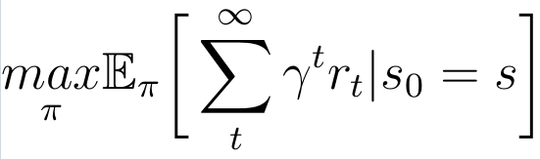
Background
Markov Decision Processes
MDP is a 4-tuple <S, A, T, R>
  S is the set of states in the MDP
  A is the set of actions available to the agent
  Transition Function T : S × A × S → [0, 1]
  Reward Function R : S × A × S → ℝ
Goal in RL:

Slide 4
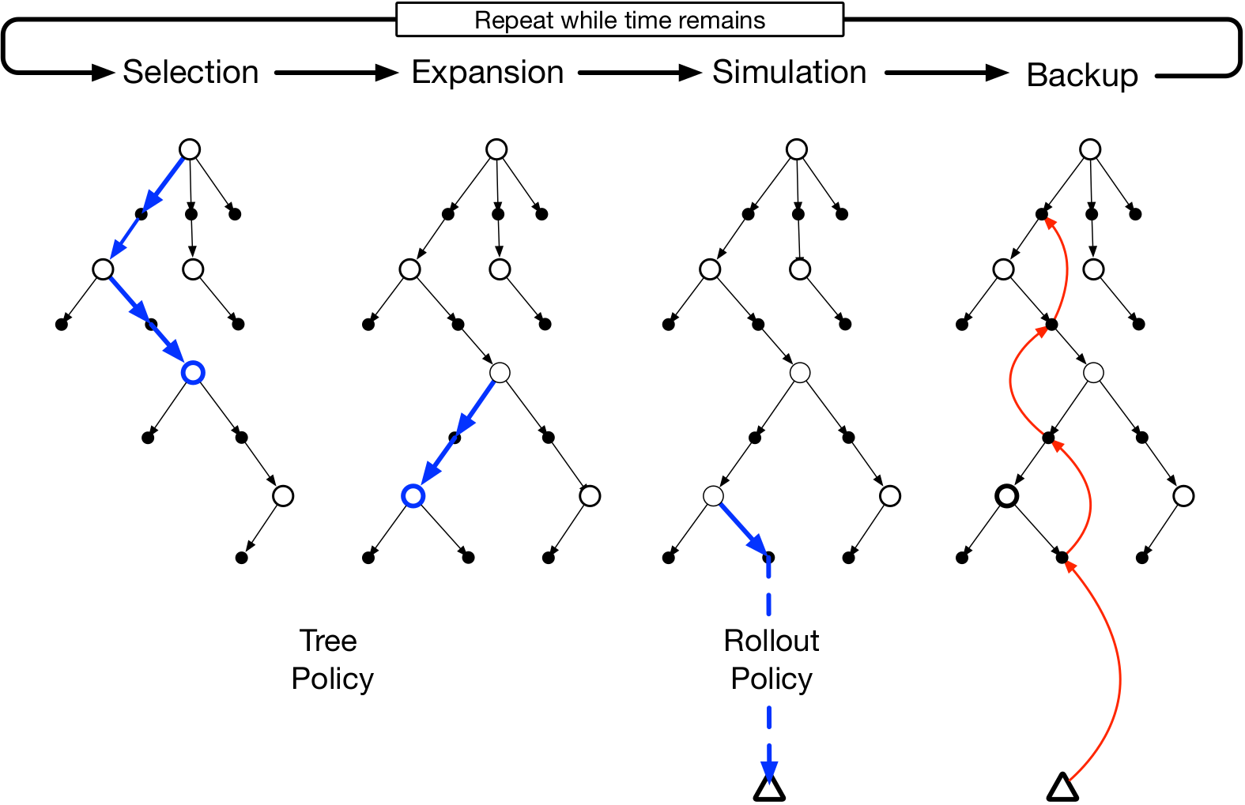
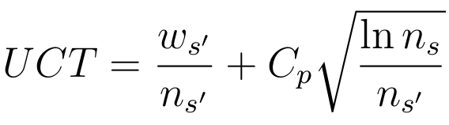


Background
Monte Carlo Tree Search
4 Phases of MCTS
UCT
  Upper Confidence Bound
  for Trees
Backup Phase in MCTS

Slide 5
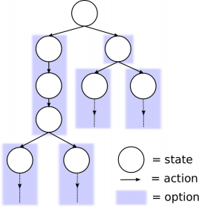
Background
Option-Monte Carlo Tree Search
Options: triple <Iº, πº, βº>
  Iº = Initiation Set
  πº : A × S → [0, 1] – Option policy
  βº : S → [0, 1] − Termination condition
O-MCTS
  Uses predefined options & single discount
  factor for all discounting

Slide 6
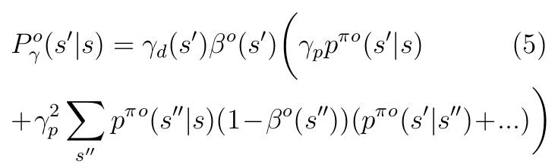
Background
Per-Decision Option Discounting
Different Discount factors for options:
  Γº = {ɣ_{r}º, ɣ_{p}º, ɣ_{d}º}
  ɣ_{p}º >ɣ_{r}º

Slide 7
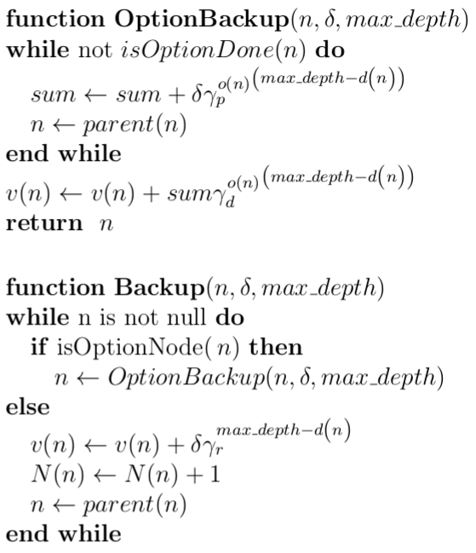
DDO-MCTS
Combination of Per-Decision Option Discounting and
O-MCTS
  Modified Backup function

Slide 8
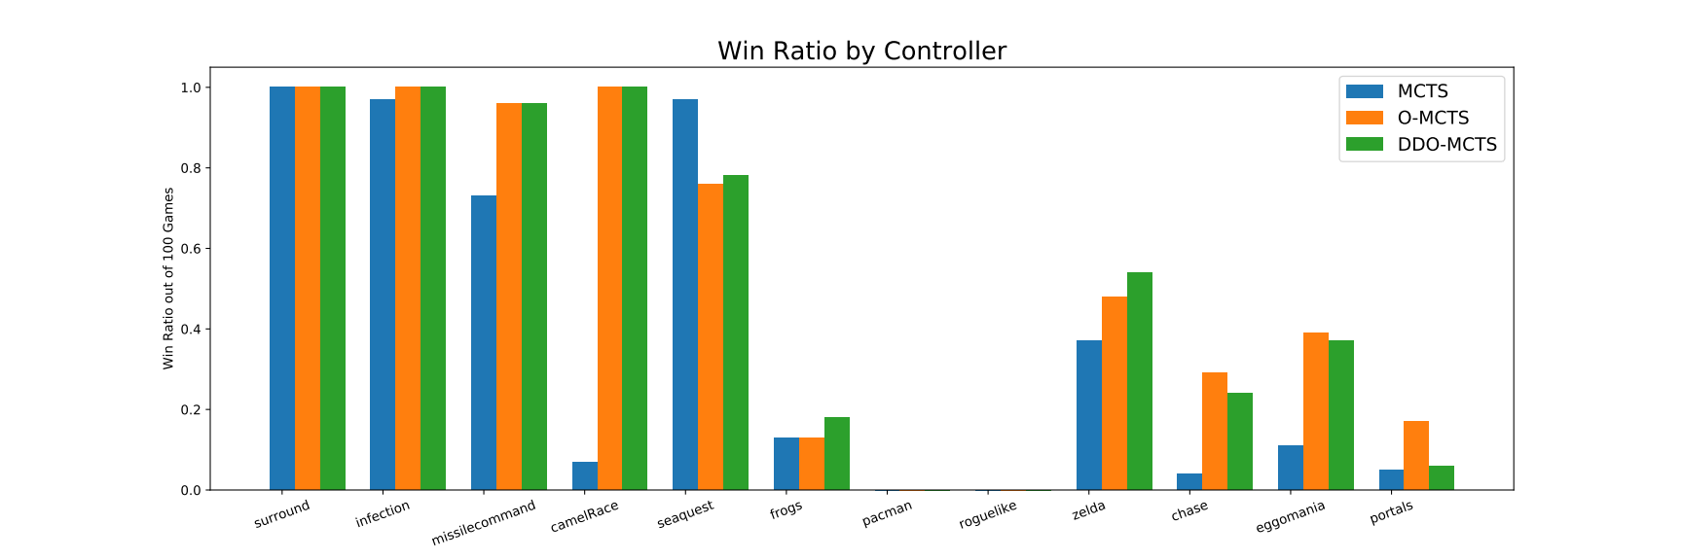
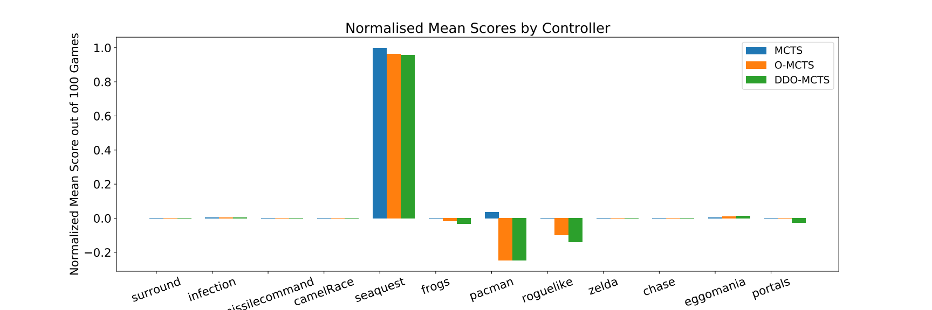
Setup & Results
Comparing DDO-MCTS with MCTS and O-MCTS
GVG-AI Games
Performance Metric
  Win/Loss ratio
  Normalised Mean Scores

Slide 9
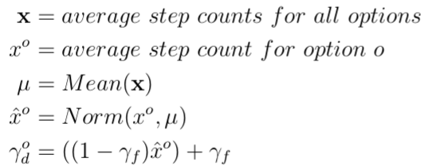
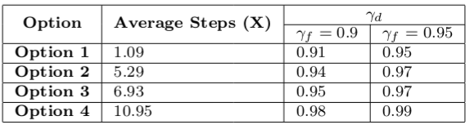
ɣ_{d}-tuning
Sets ɣ_{d} given ɣ_{f} and average step counts for options

Slide 10
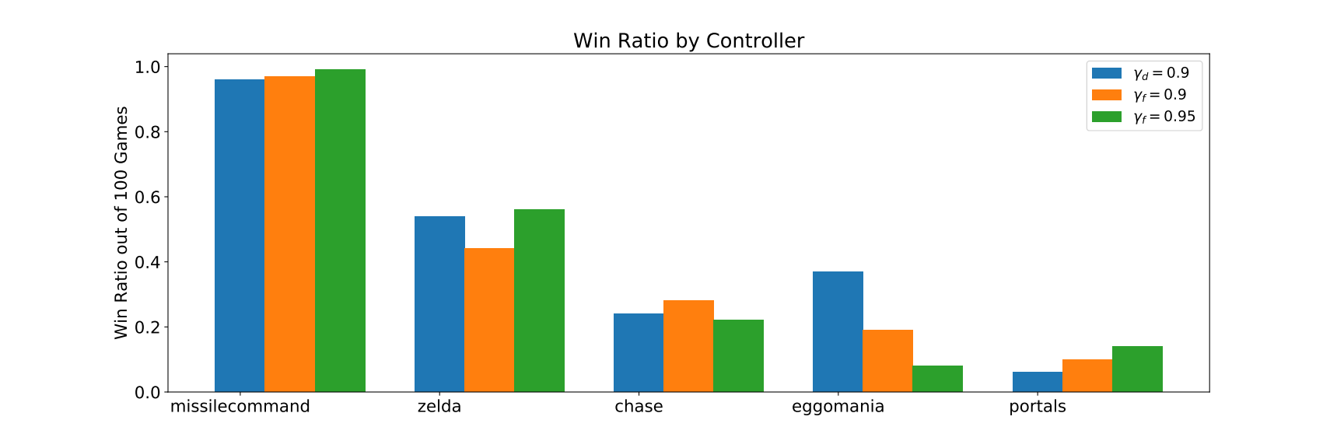
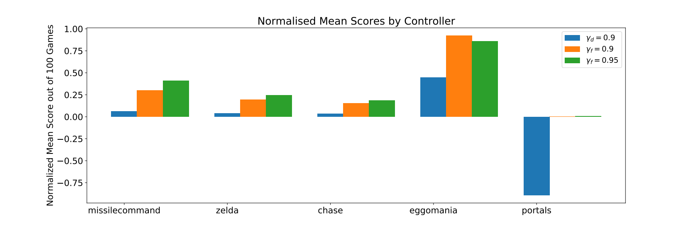
ɣ_{d}-tuning results

Slide 11
Conclusion & Evaluation
DDO-MCTS shows some performance increase in some games, but not significant enough.
Ɣ_{d}-tuning works, but can depend on a per game basis

Slide 12
Further Work
Some form of ɣ_{d}-tuning, using average steps and reward per option, rather than just average steps
Ɣ_{d}-tuning done while playing games

Slide 13
References
[1] Murray Campbell, A. Joseph Hoane Jr., and Feng-hsiung Hsu. “Deep Blue”. In: Artif. Intell. 134.1-2 (Jan. 2002), pp. 57– 83. issn : 0004-3702. doi : 10 . 1016 / S0004-3702(01)00129-1 . Url : http: / / dx . doi . org / 10 . 1016 / S0004 – 3702(01)00129-1.
[2] R ́emi Coulom. “Efficient selectivity and backup operators in Monte-Carlo tree search”. In: In: Proceedings Computers and Games 2006 . Springer-Verlag, 2006.
[3] Anna Harutyunyan et al. “Per-Decision Option Discounting”. In: Proceedings of the 36th International Conference on Machine Learning . Ed. by Kamalika Chaudhuri and Ruslan Salakhutdinov. Vol. 97. Proceedings of Machine Learn- ing Research. Long Beach, California, USA: PMLR, Sept. 2019, pp. 2644– 2652. url : http://proceedings.mlr.press/v97/harutyunyan19a.html.
[4] Levente Kocsis and Csaba Szepesv ́ari. “Bandit Based Monte-carlo Planning”. In: Proceedings of the 17th European Conference on Machine Learning. ECML’06. Berlin, Germany: Springer- Verlag, 2006, pp. 282–293. isbn : 3-540- 45375-X, 978-3-540-45375-8. doi : 10 . 1007/11871842_29 . url : http://dx.doi.org/10.1007/11871842_29.
[5] T. Schaul. “A video game description language for model-based or interactive learning”. In: 2013 IEEE Conference on Computational Inteligence in Games (CIG). Aug. 2013, pp. 1–8. doi : 10 . 1109/CIG.2013.6633610.
[6] David Silver et al. “Mastering the Game of Go with Deep Neural Networks and Tree Search”. In: Nature 529.7587 (Jan. 2016), pp. 484–489. doi : 10 . 1038 / nature16961.
[7] Richard S Sutton and Andrew G Barto. Reinforcement learning: An introduction. MIT press, 1998.
[8] Richard S Sutton, Doina Precup, and Satinder Singh. “Between MDPs and semi-MDPs: A framework for temporal abstraction in reinforcement learning”. In: Artificial intelligence 112.1 (1999), pp. 181–211.
[9] Maarten de Waard. “Monte Carlo Tree Search with Options for General Video Game Playing”. PhD thesis. University of Amsterdam, Feb. 2016.

